Slide 1
Secure data hiding in images using steganography
Presented By:
Student Name : JERRY JAMES
College Name & Department : St. Joseph’s College of Engineering and Technology, Palai
MCA (Final year)

Slide 2
OUTLINE
Problem Statement
Technology used
Wow factor
End users
Result
Conclusion
Git-hub Link
Future scope

Slide 3
Problem Statement
With the increasing threat to data privacy, secure communication has become essential.
Traditional encryption methods are easily detectable, raising suspicion.
There is a need for a method that conceals the existence of confidential data.
Steganography provides a solution by hiding data within digital media, ensuring covert communication.

Slide 4
Technology used
Programming Language: Python 3.13
Environment: VS Code
Libraries Used:
Pillow (PIL): For image processing
NumPy: For efficient array manipulation

Slide 5
Wow factors
Supports multiple image formats (PNG, JPEG, BMP).
High data capacity with minimal image quality loss.
The embedded data is undetectable to the naked eye, ensuring confidentiality.
Error-handling mechanisms to prevent data loss during retrieval.

Slide 6
End users
Government Agencies: For secure communication of sensitive information.
Corporate Organizations: To protect trade secrets and confidential files.
Journalists and Activists: For secure information sharing in high-risk environments.
General Users: For personal data protection and privacy.

Slide 7
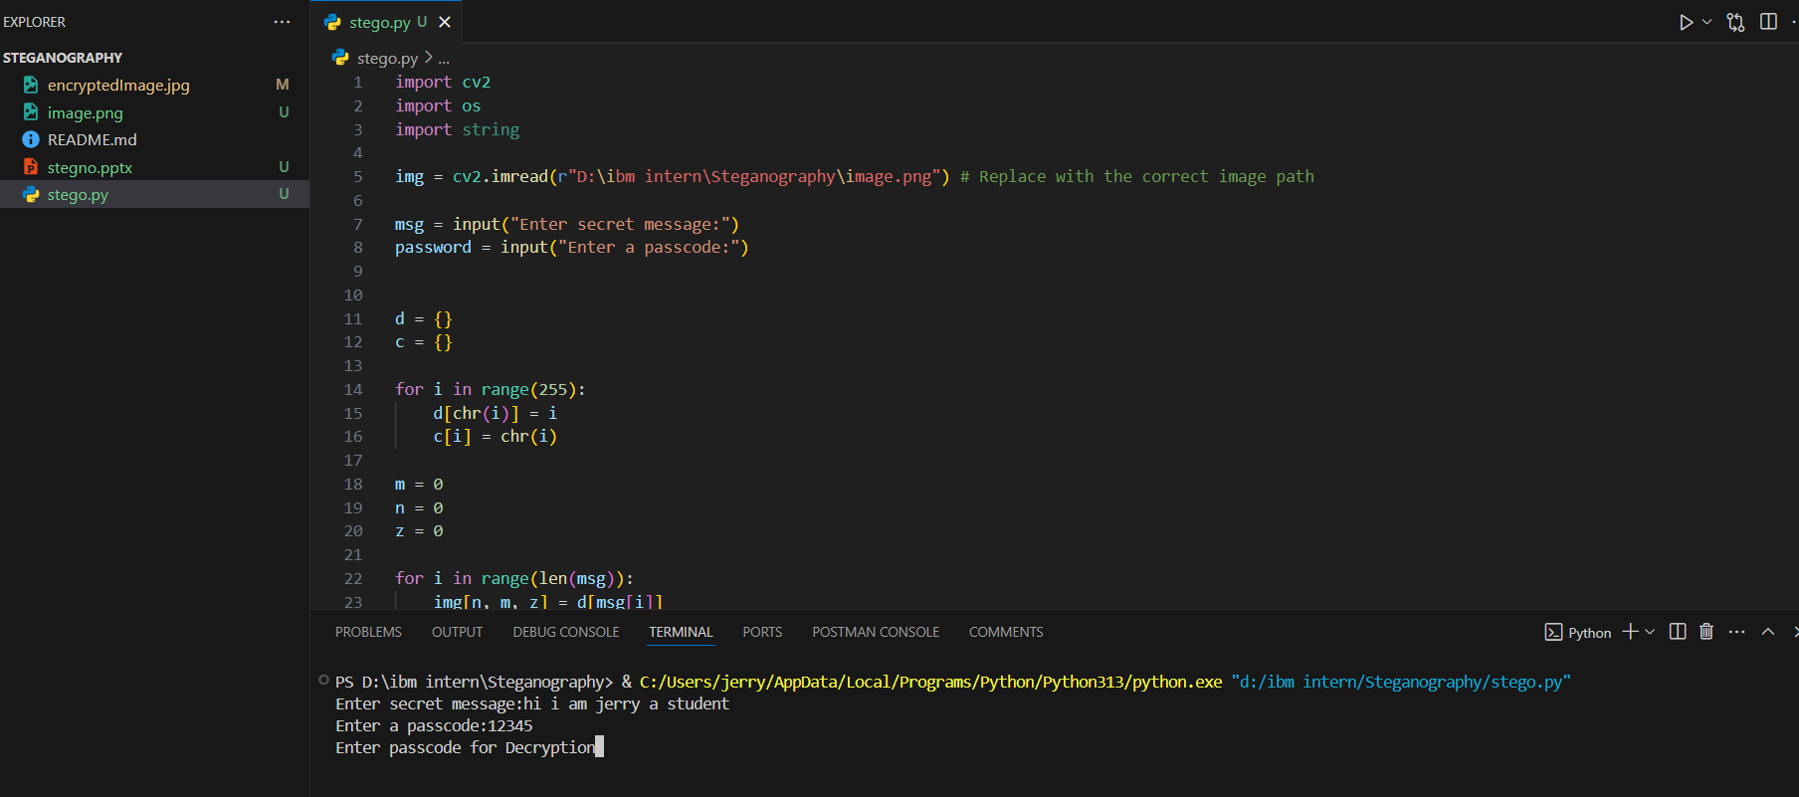
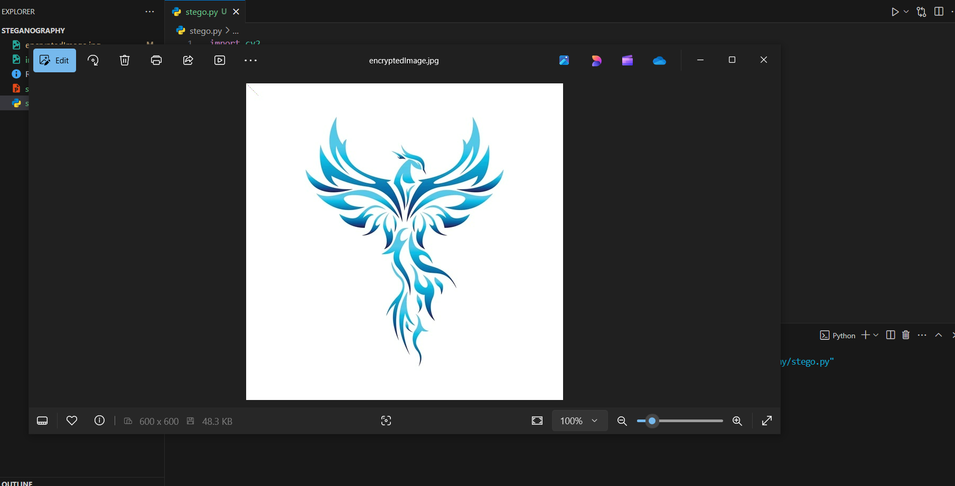
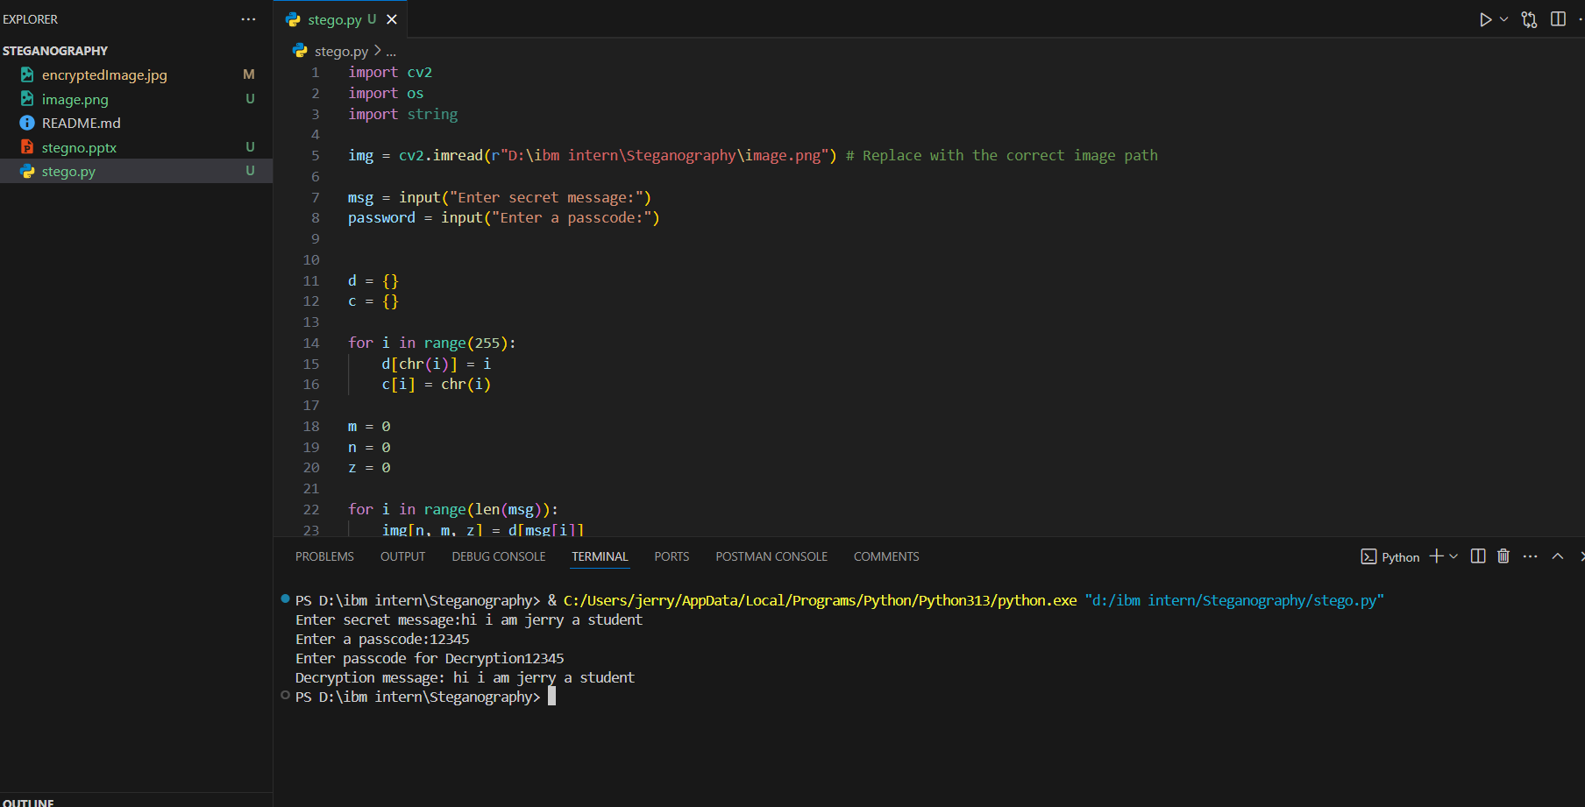
Results
Successfully embedded text files into various image formats.
Maintained image quality with negligible distortion.
Accurate data retrieval with no loss during decoding.
Performance tested with large datasets while ensuring quick processing times.

Slide 8
Conclusion
The project successfully demonstrates secure data hiding using steganography.
Achieved confidentiality by making the hidden data imperceptible.
Python libraries ensured efficient and scalable development.
The solution can be extended for secure transmission of sensitive information in real-world applications.

Slide 9
GitHub Link
https://github.com/jerryjames2001/Steganography.git

Slide 10
Future scope(optional)
Integration with audio and video steganography for broader applications.
Enhancing security by combining encryption with steganography.
Developing mobile applications for on-the-go data hiding.
Optimizing performance for handling larger multimedia files.

Slide 11
THANK YOU

